Slide 1

Fecality of Science and Engineering
Department of Computer Science and Engineering
CSE 498 Project and Presentation

Slide 2
Project Title:
Auto Pilot: Web analysis tool and user tracking system.

Slide 3

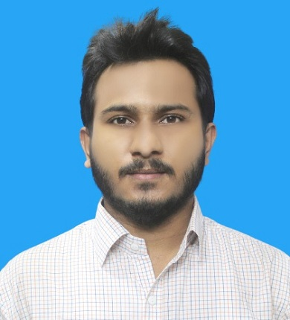
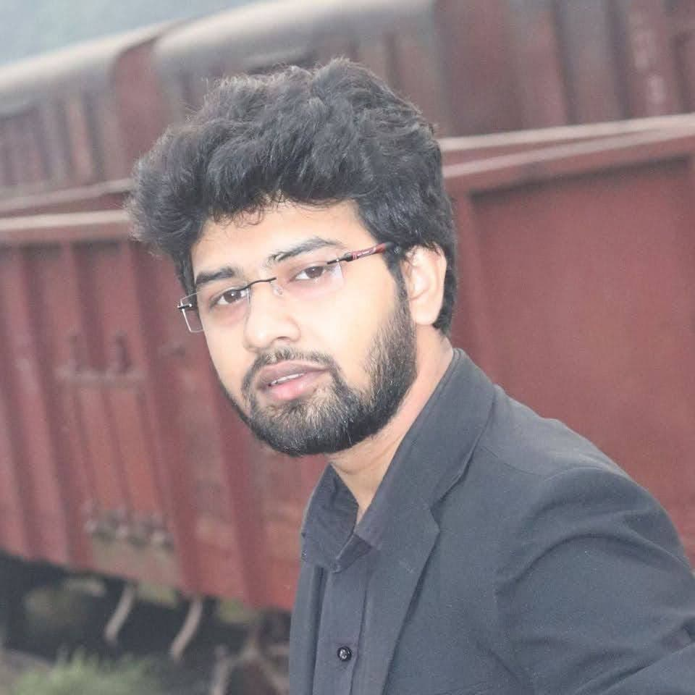
Supervisor
Ataullah Bhuiyan
Senior Lecturer & Coordinator, Dept. of CSE
City University
Presented By
Mushahadur Rahman Khan
ID: 1834902513
Hasibul Islam
ID: 182482526

Slide 4
Presentation Outline:
Introduction
Problem Statement
Background study
Existing work
Motivation and Objectives
Features
Scope and Future work
Using Technology
Development Requirements
Development Tools
Budget
Target User
Time Limit
Team Work distribution
Gantt chart
Limitations of our project
Conclusion
References

Slide 5
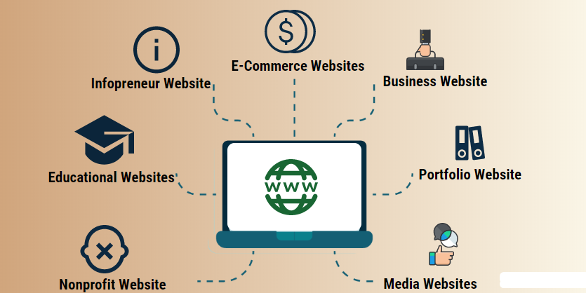
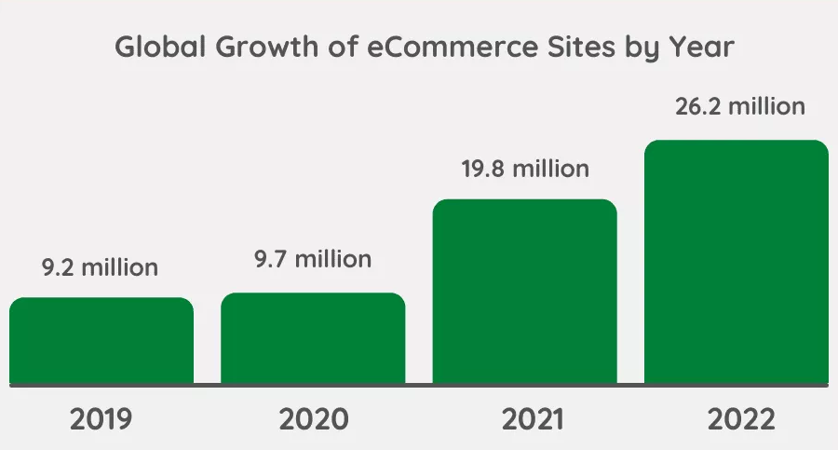
Introduction:

Slide 6


Problem Statement:

Slide 7
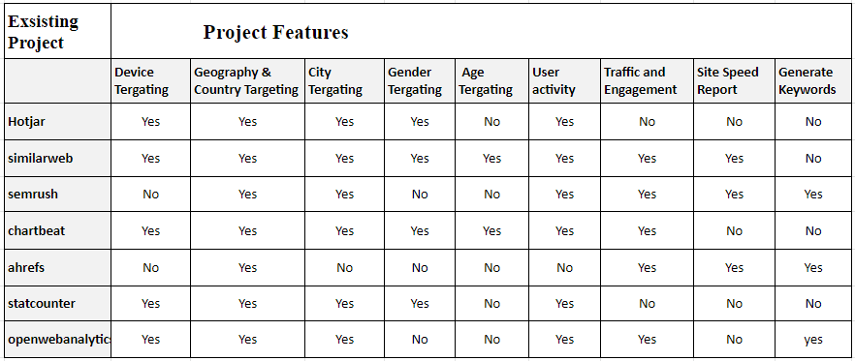
Background study and Existing work:

Slide 8
Motivation and Objectives:
To help customize all types of websites including e-commerce websites in the right way.
To help ensure entrepreneurs with accurate information.
Every website user can find and improve their website errors.

Slide 9
Features
Register with Google or GitHub.
Traffic and Engagement
Geography & Country Tracking
Audience Demographics
Generate Keywords
Authorization and Authentication

Slide 10
Scope and Future work
User Analysis and For Product and Boosting
Tracking Exact Location
Suggest Related or another services
Datamining for using AI/ML
Extra Facilities for premium members
Making boot for SEO.
Automatic Set Keyword for Individual Post

Slide 11
Using Technology
Particular | The Technologies That Can Be Used
Programming Language | PHP 7.2 +
CMS | Laravel or Node JS
Designing | HTML5, CSS3, Bootstrap4, React JS
Others Scripting | JavaScript, JQuery
Database | MySQL or MongoDB
API Development | Laravel Lumen, Google Auth API, Others

Slide 12
Development Requirements
To develop a project a medium configured computer is needed. Below the minimum requirements given:
CPU: core i3 6th
RAM: 4 GB
Hard Disk: 500 GB
Apache server
Node JS Server
PHP Parser
MySQL / MongoDB Database

Slide 13
Development Tools
Some of the tools that I will use for development are mentioned below:
PHP Storm
Web Storm
Visual Studio Code
XAMPP / WAMP Server
Postman
Adobe XD

Slide 14
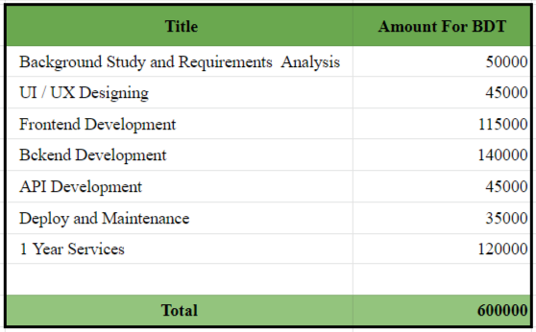
Budget
A draft of the estimated cost to complete this project is presented.

Slide 15


Target User:
Single or multiple companies
(Startup to Middle East).
Personal team working.

Slide 16
Time Limit:
01/08/2022 to 31/10/2022 approximately three months

Slide 17
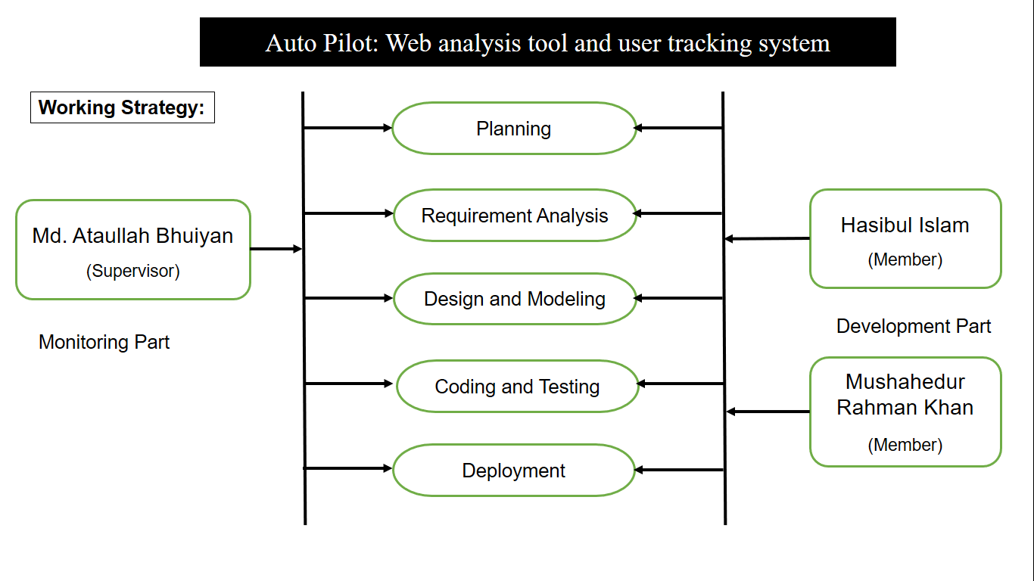
Team Work Distribution:

Slide 18
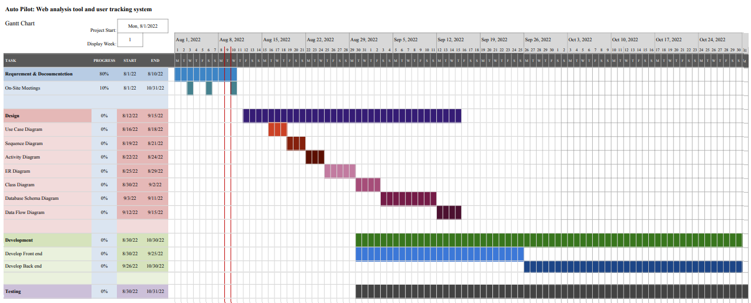
Gantt Chart:

Slide 19
Limitations Of Your Project:
Insufficient storage
Lack of sufficient data

Slide 20
Conclusion:
Using our website analysis system, users can register with us here and then provide the URL of their website, and we will create a code on their entire site based on the address of the URL. When you update your site's index tag, it will be activated in our system, which shows the user an overview of the site where he can learn how much time he has spent online and what percentage of men and women are on the site. We can give him good advice on how he can improve his website if he wants and he can find the right competitor for this competition.

Slide 21
References:

